Slide 1
Objective
The purpose of this lab is to explore model selection, evaluation, and hyperparameter tuning using two widely-used real-world datasets.
Compare the performance of a naive train-test split with k-fold cross-validation.
Implement hyperparameter tuning using GridSearchCV (or RandomizedSearchCV) for Logistic Regression (binary classification) and Linear Regression (regression).
Compare evaluation metrics: Accuracy and F1 Score for classification; Mean Squared Error (MSE) and R2 for regression.
Display visualizations directly in the document for all comparisons.

Slide 2
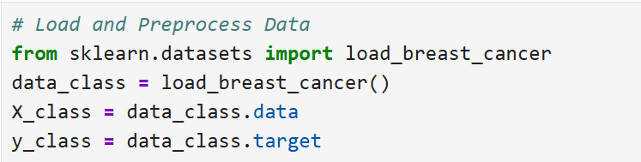
Dataset 1: Breast Cancer Wisconsin (Diagnostic) Dataset
Loda the dataset
Handle missing values if present.
Split the dataset into features (X) and binary target labels (y).
Normalize or standardize the features.
Notes:
Binary classification using Logistic Regression.

Slide 3
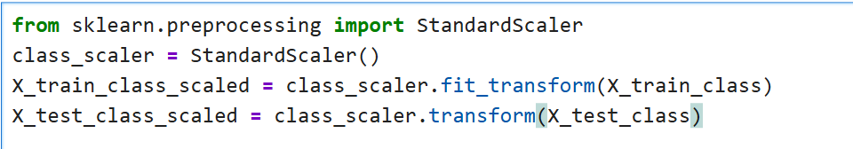

Slide 4
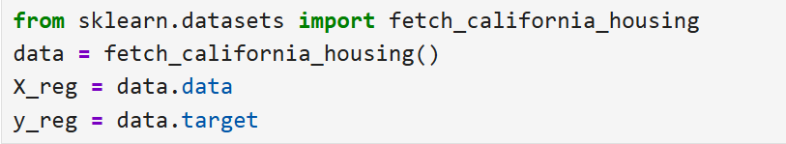
Dataset 2: Breast Cancer Wisconsin (Diagnostic) Dataset
Loda the dataset
Handle missing values if present.
Split the dataset into features (X) and the continuous target variable (y).
Apply feature scaling as needed.
Notes:
Regression using Linear Regression.

Slide 5
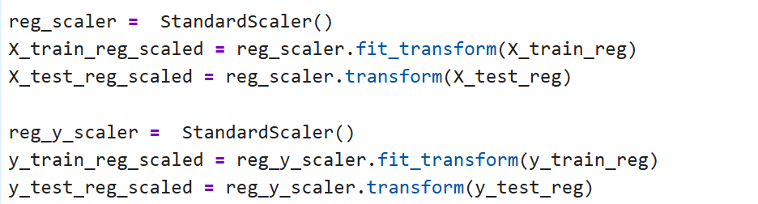

Slide 7
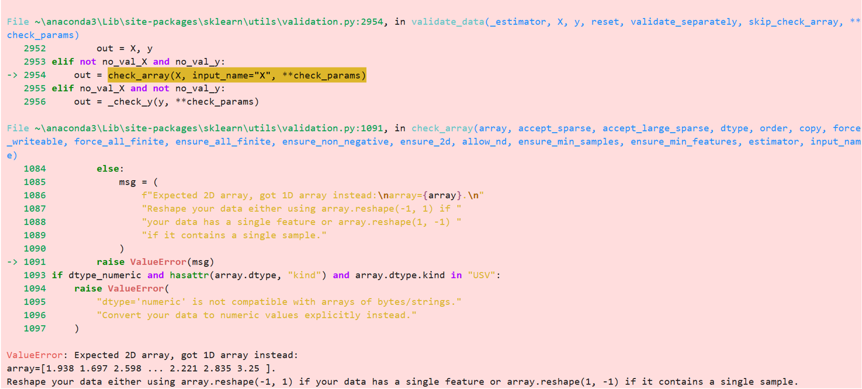

Slide 9
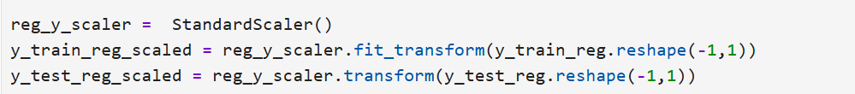

Slide 10
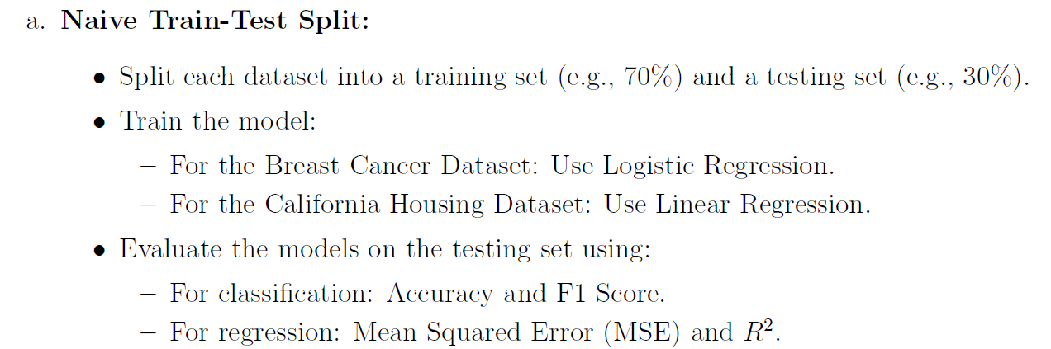
Task 1: Evaluation with Train-Test Split vs. Cross-Validation
Notes:
Regression using Linear Regression.

Slide 11
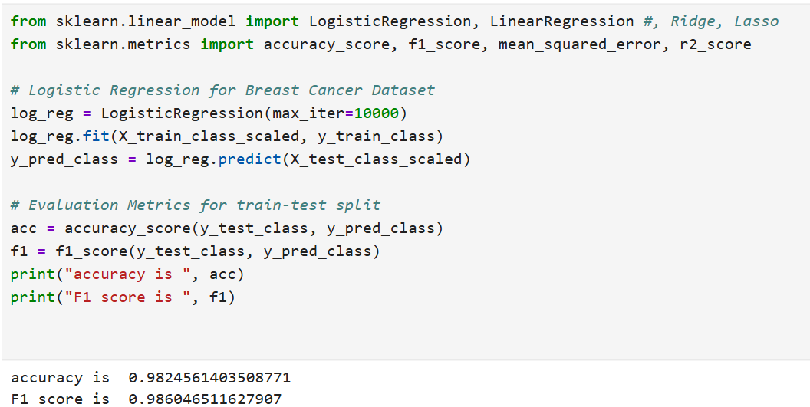

Slide 12
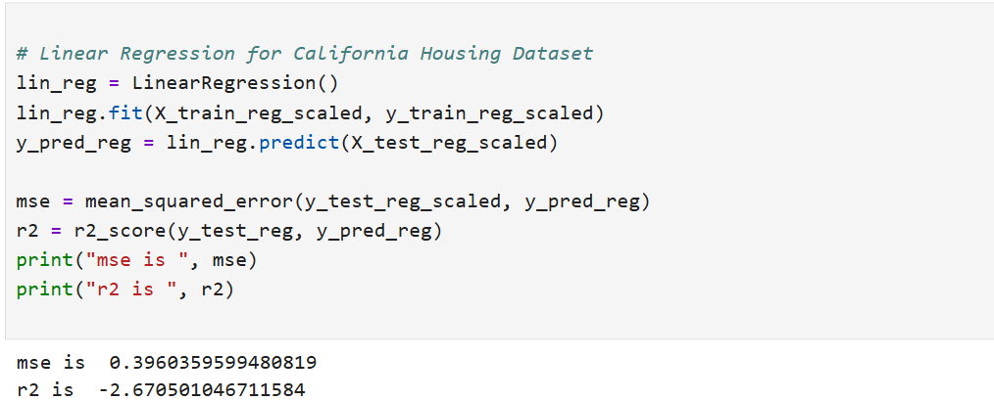

Slide 13
?

Slide 14

?

Slide 15
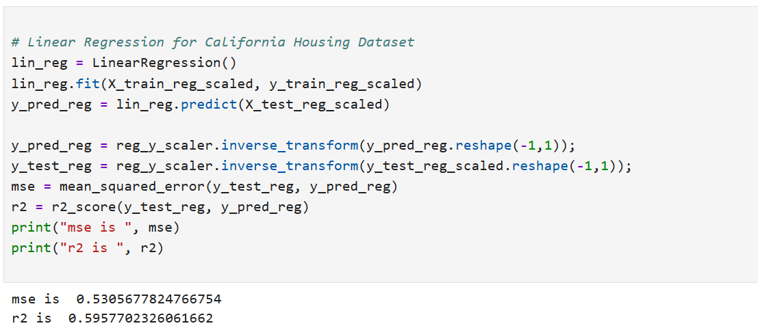

Slide 18
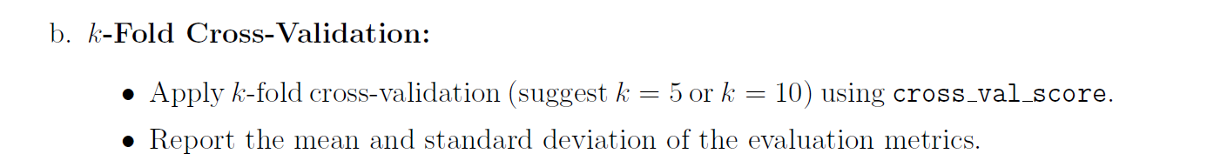
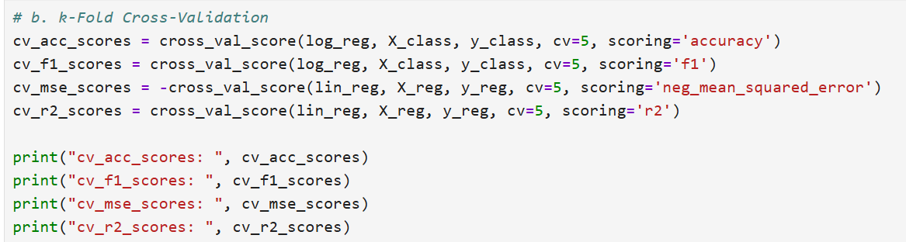
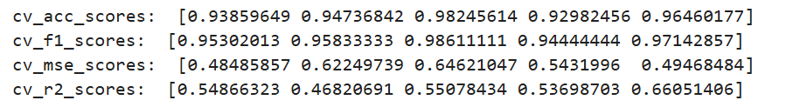

Slide 19
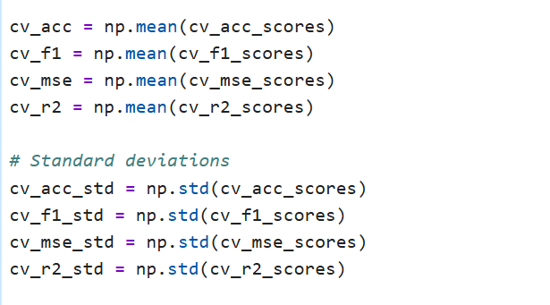

Slide 20
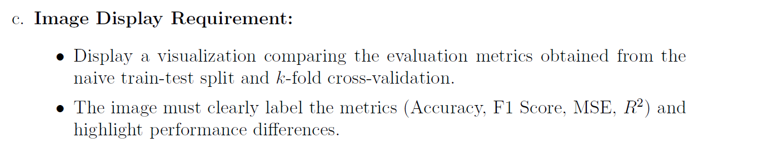
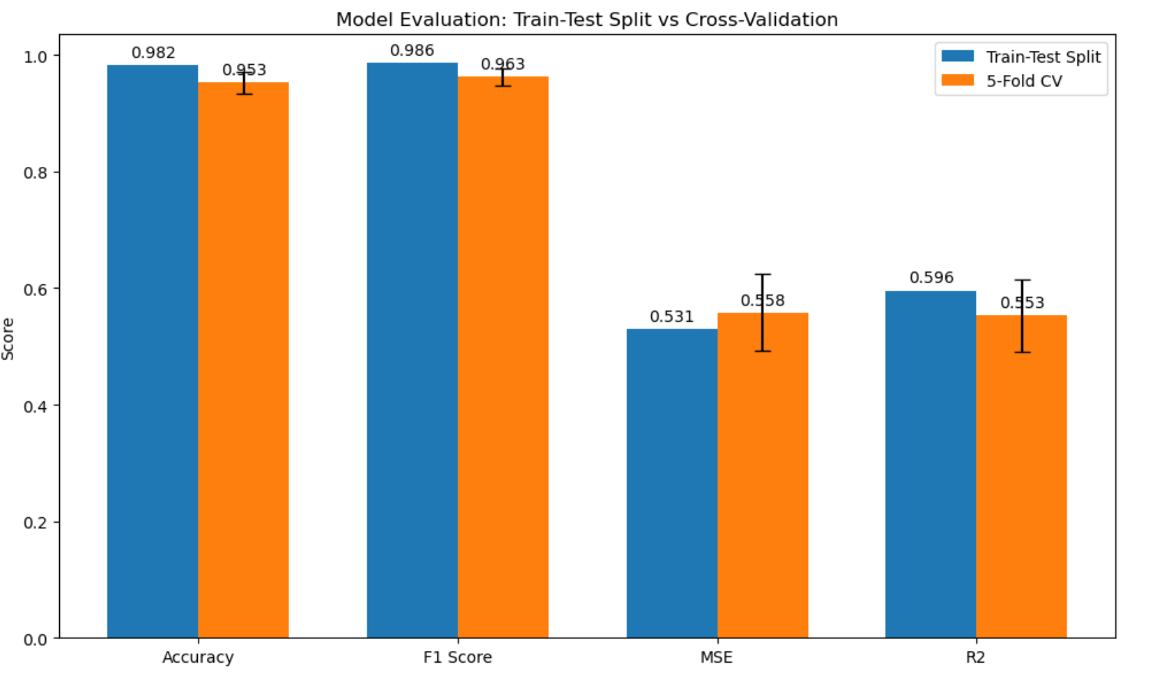

Slide 21
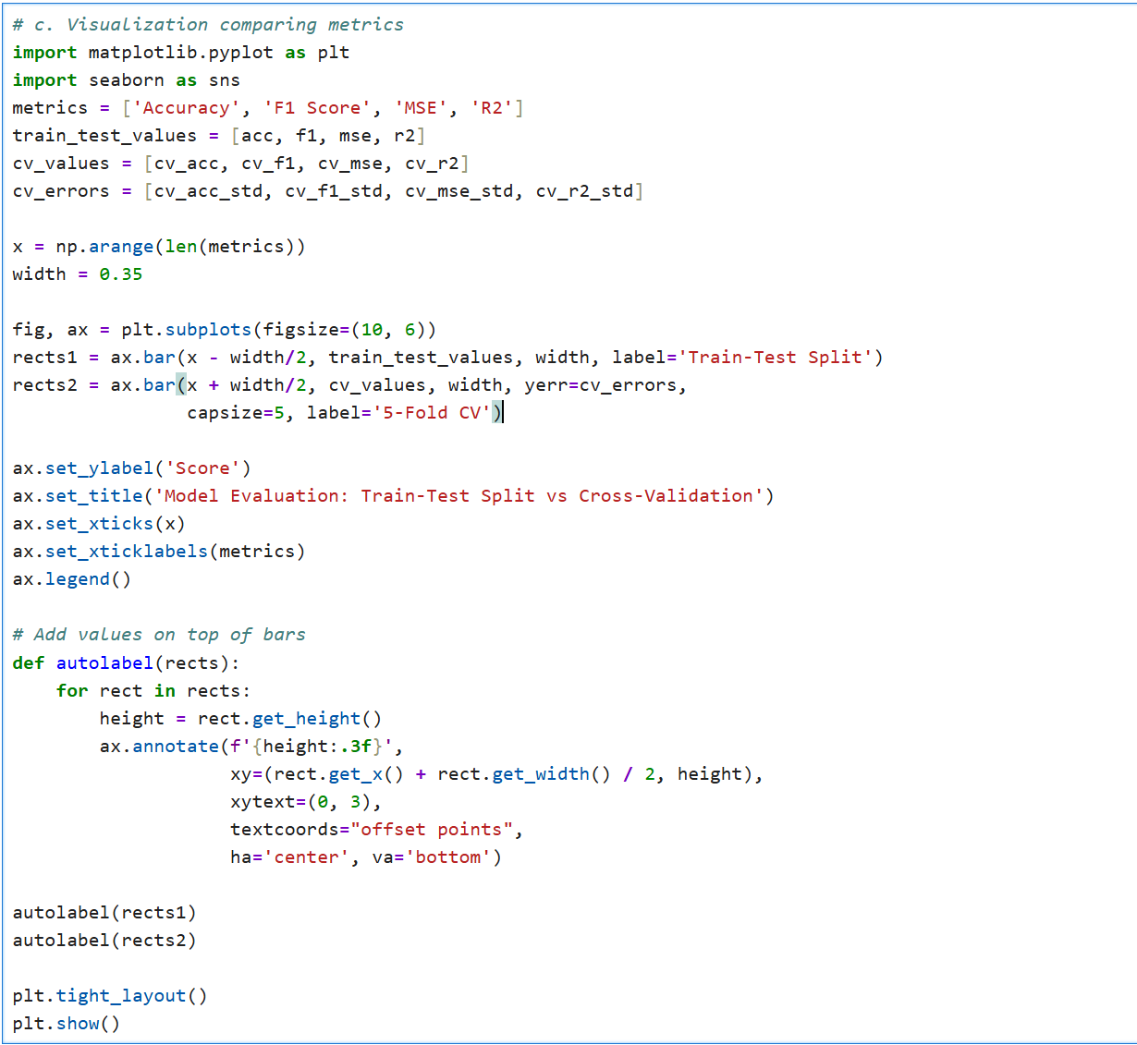

Slide 22
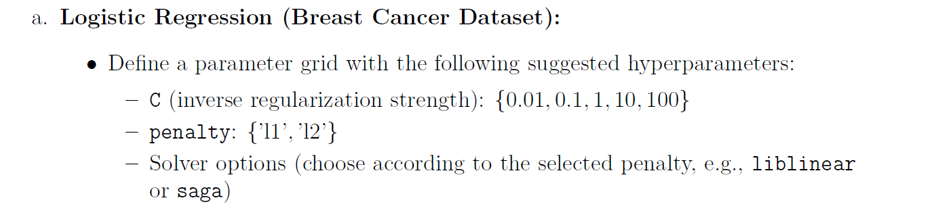
Task 2: Hyperparameter Tuning with GridSearchCV
(or RandomizedSearchCV)
Notes:
Regression using Linear Regression.

Slide 23
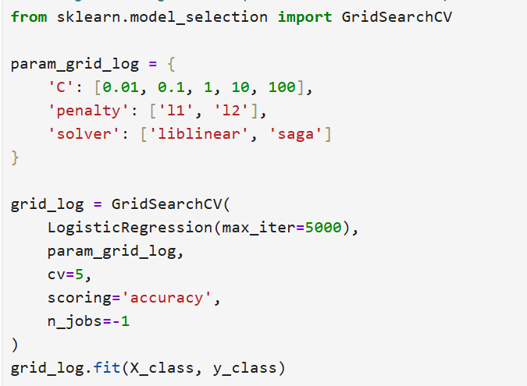
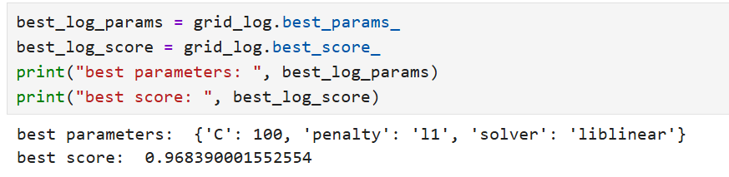

Slide 24
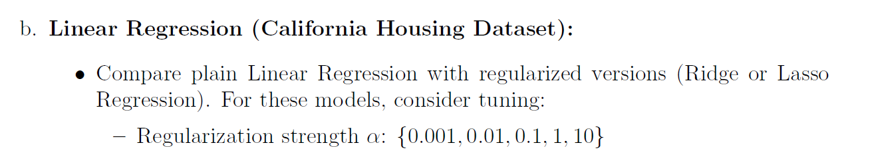
Task 2: Hyperparameter Tuning with GridSearchCV
(or RandomizedSearchCV)
Notes:
Regression using Linear Regression.

Slide 25
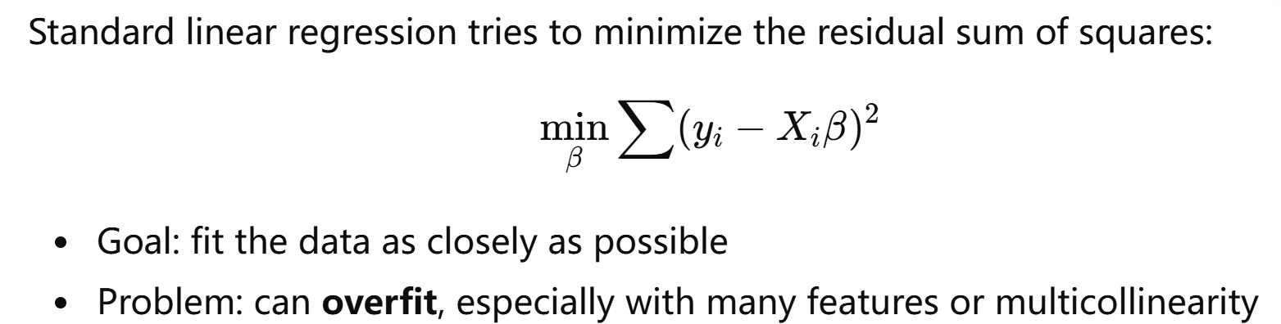

Slide 26
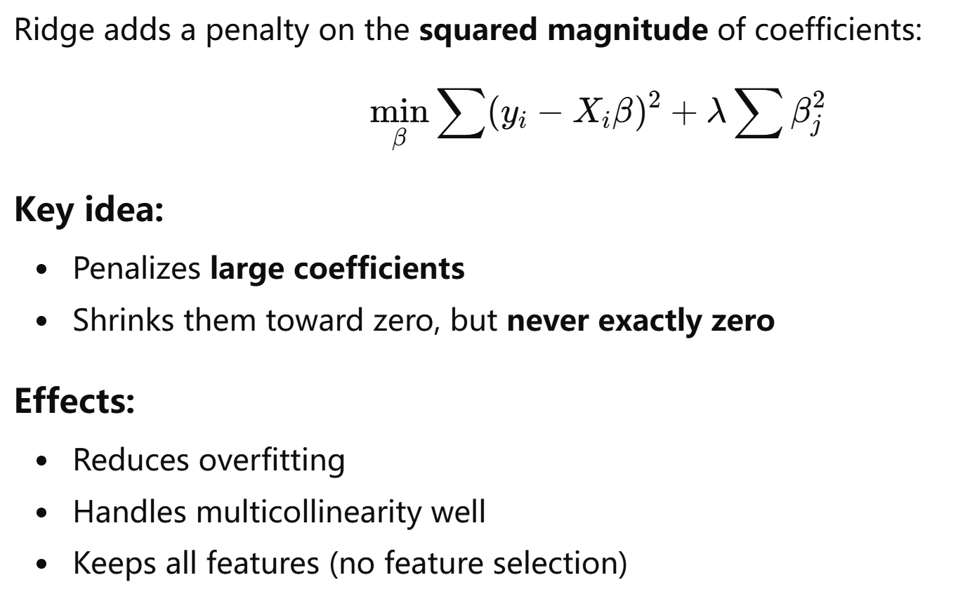
Notes:
L2 Regularization

Slide 27
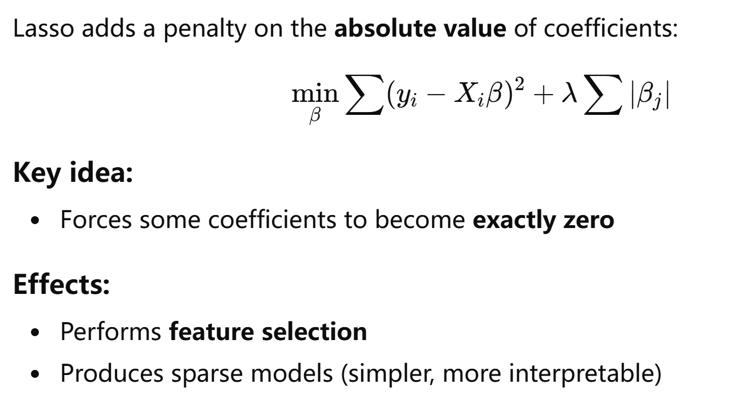
Notes:
L1 Regularization

Slide 29
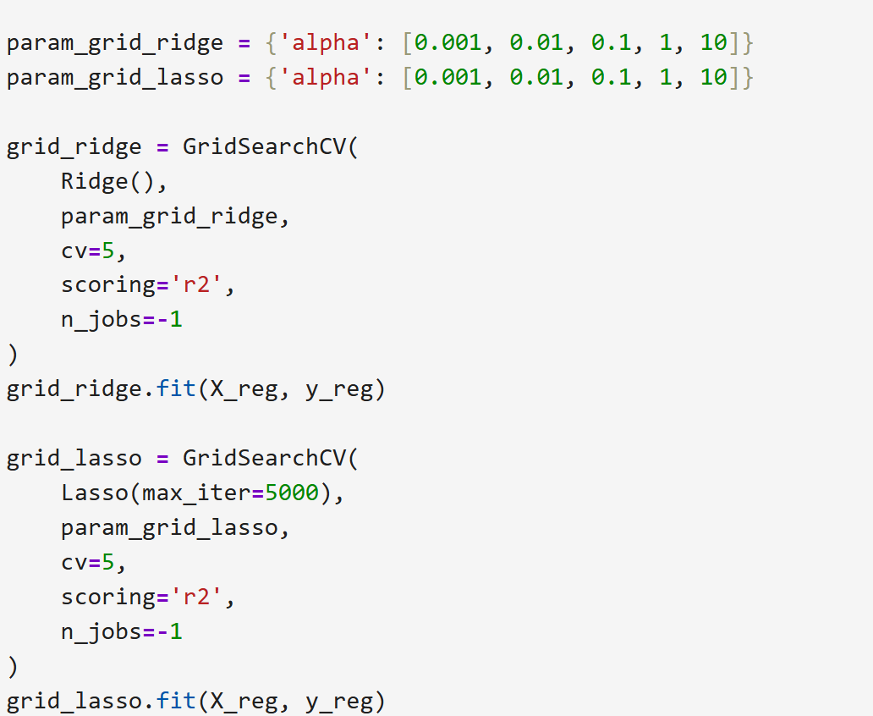

Slide 30
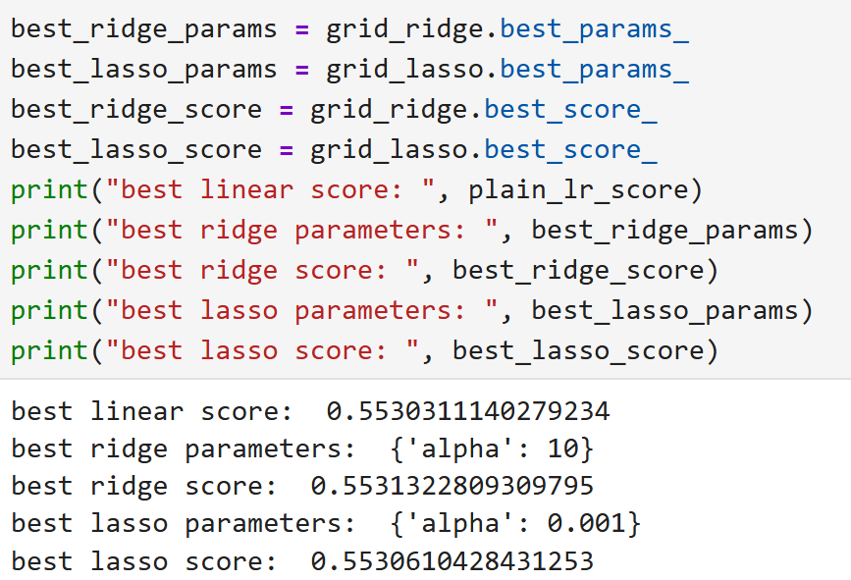

Slide 31
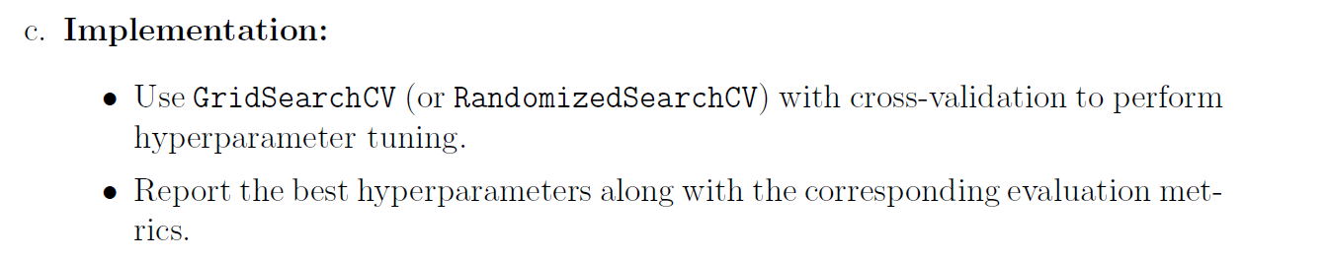

Slide 32
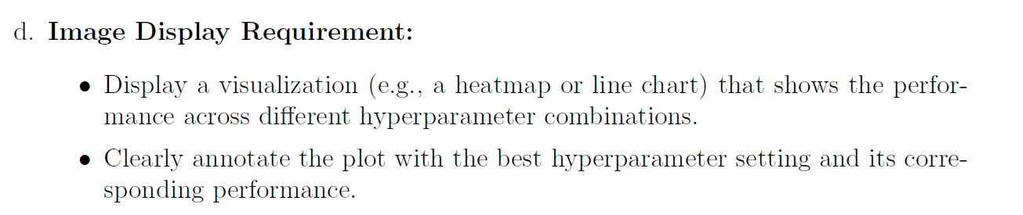

Slide 33
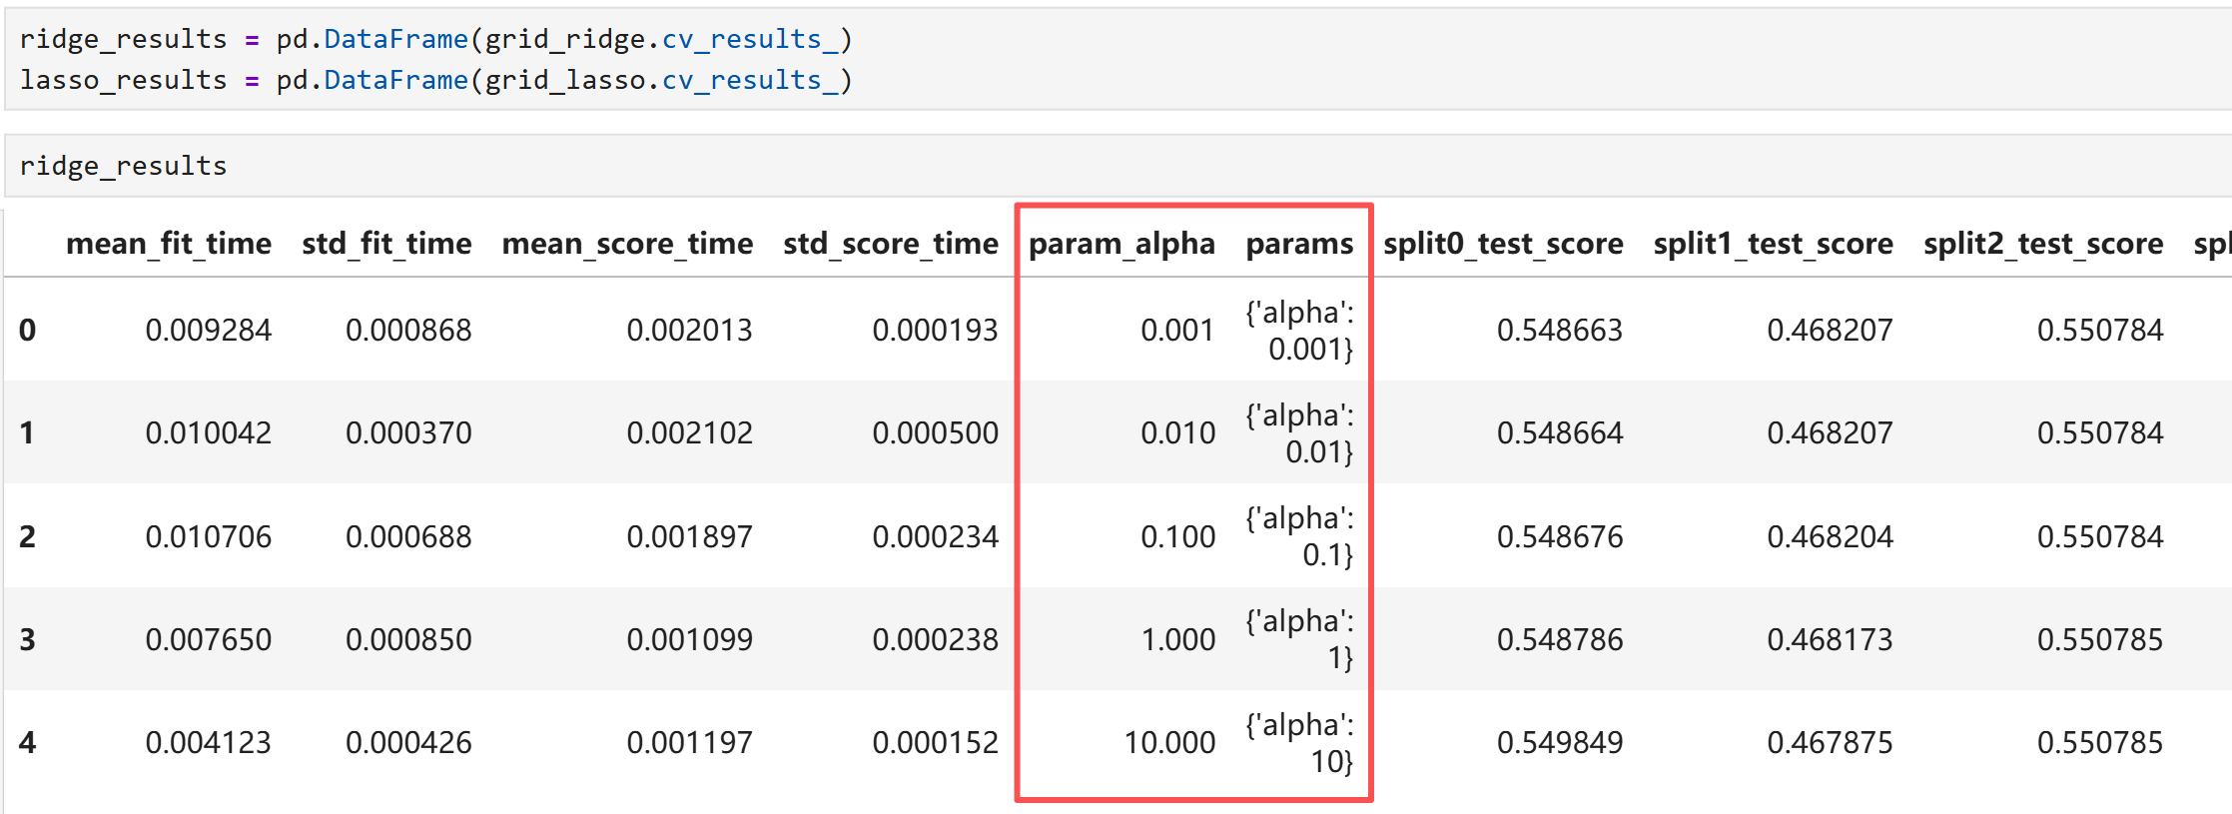

Slide 34
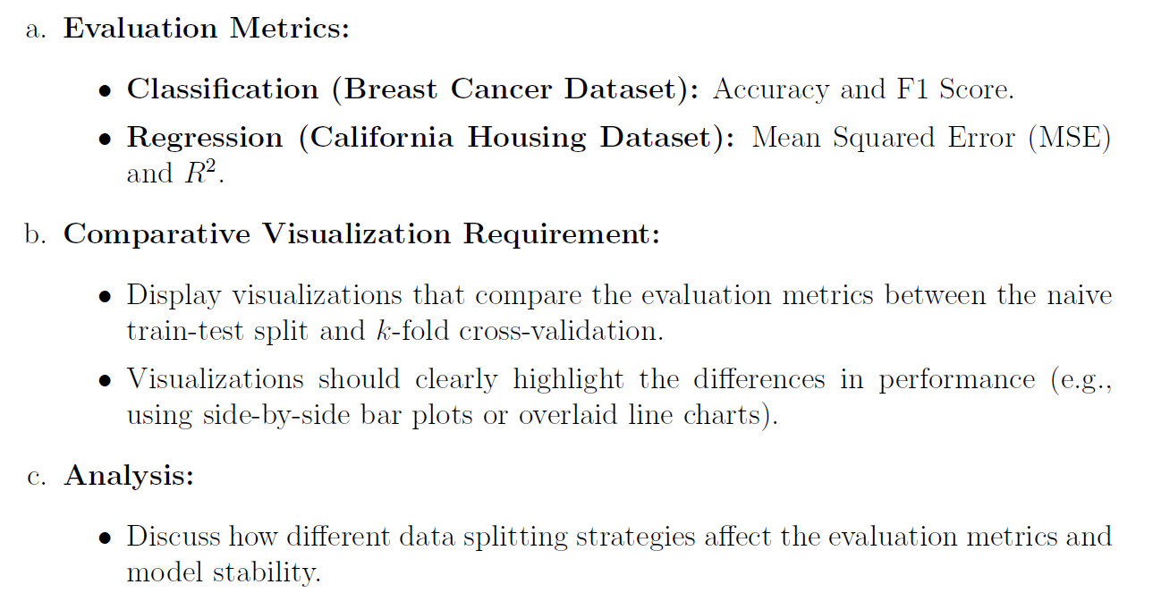
Task 3: Comparison and Analysis

Slide 35
